Slide 1
StarlingX Project Overview
Learn, Try, Get Involved!

Slide 2
Let Me Introduce StarlingX
Top-level Open Infrastructure Foundation project
Software stack providing critical infrastructure and management services for distributed cloud applications
Frequent releases
  https://opendev.org/starlingx
  https://mirror.starlingx.windriver.com/mirror/starlingx/release/
Growing community
  Inviting users, operators and developers to try out the software and participate in the community

Slide 3
Project Overview

Slide 4
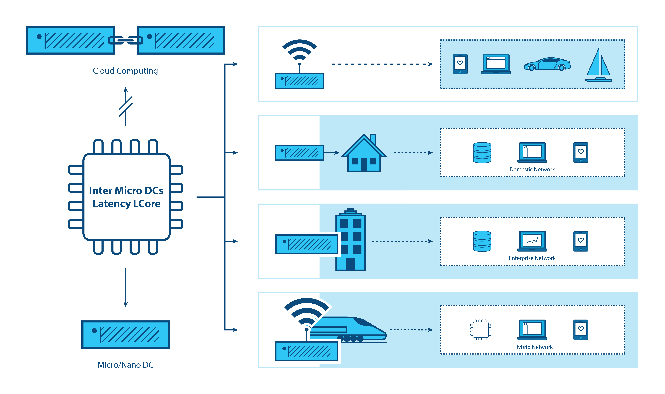
What Is Driving Edge Computing?
Latency
Bandwidth
Security
Connectivity
“WHERE” MATTERS
~100ms
~10-40ms
< 5ms
< 1-2ms
Notes:
For over a decade, centralized cloud computing has been considered a standard IT delivery platform. Though cloud computing is ubiquitous, emerging requirements and workloads are beginning to expose some limitations. While the standard Cloud data center model works extremely well for millions of applications, there are other applications which can greatly benefit by moving computing resources out of the datacenter and closer to the Edge of the network where decreased latency and higher performance provides significant value. Few developers seriously considered the requirements needed to support resource-constrained nodes reachable only over unreliable or bandwidth-limited network connections, or thought about the needs of applications that demand very high bandwidth, low latency, or widespread compute capacity across many sites. That is all starting to change as more and more use cases for Edge Computing are emerging.

Slide 5

Use Case Frontiers
Re-Configure Proven Cloud Technologies for Distributed Compute
Orchestrate system-wide
    Deploy and manage remote clouds, share configurations
Simplify deployment to geographically dispersed, remote regions
OpenStack
Transportation
Energy
Kubernetes
Manufacturing
Retail
Ceph
Video
Smart cities
QEMU/KVM
Healthcare
Drones
*Other names and brands may be claimed as the property of others
Notes:
Technology companies have now spent a couple decades evolving Cloud computing to its current state of robustness. Linux blazed a trail of open source success. And newer technologies have spun out of the creative energies that vibrant open source communities can foster. This is apparent where new Cloud deployments use hypervisors and virtual machines with containers under an umbrella of orchestration.
StarlingX takes these successful open source Cloud components and makes them a viable platform in the somewhat different arena of the distributed Edge. Re-configuring these strengths, it must also take into account geographic dispersion, low overhead communications, and the need to manage very large hardware deployments.
It needs to be Cloud-like in many aspects, but it has to be simple to deploy, distribute and manage.
This is the goal of the project we call StarlingX.

Slide 6
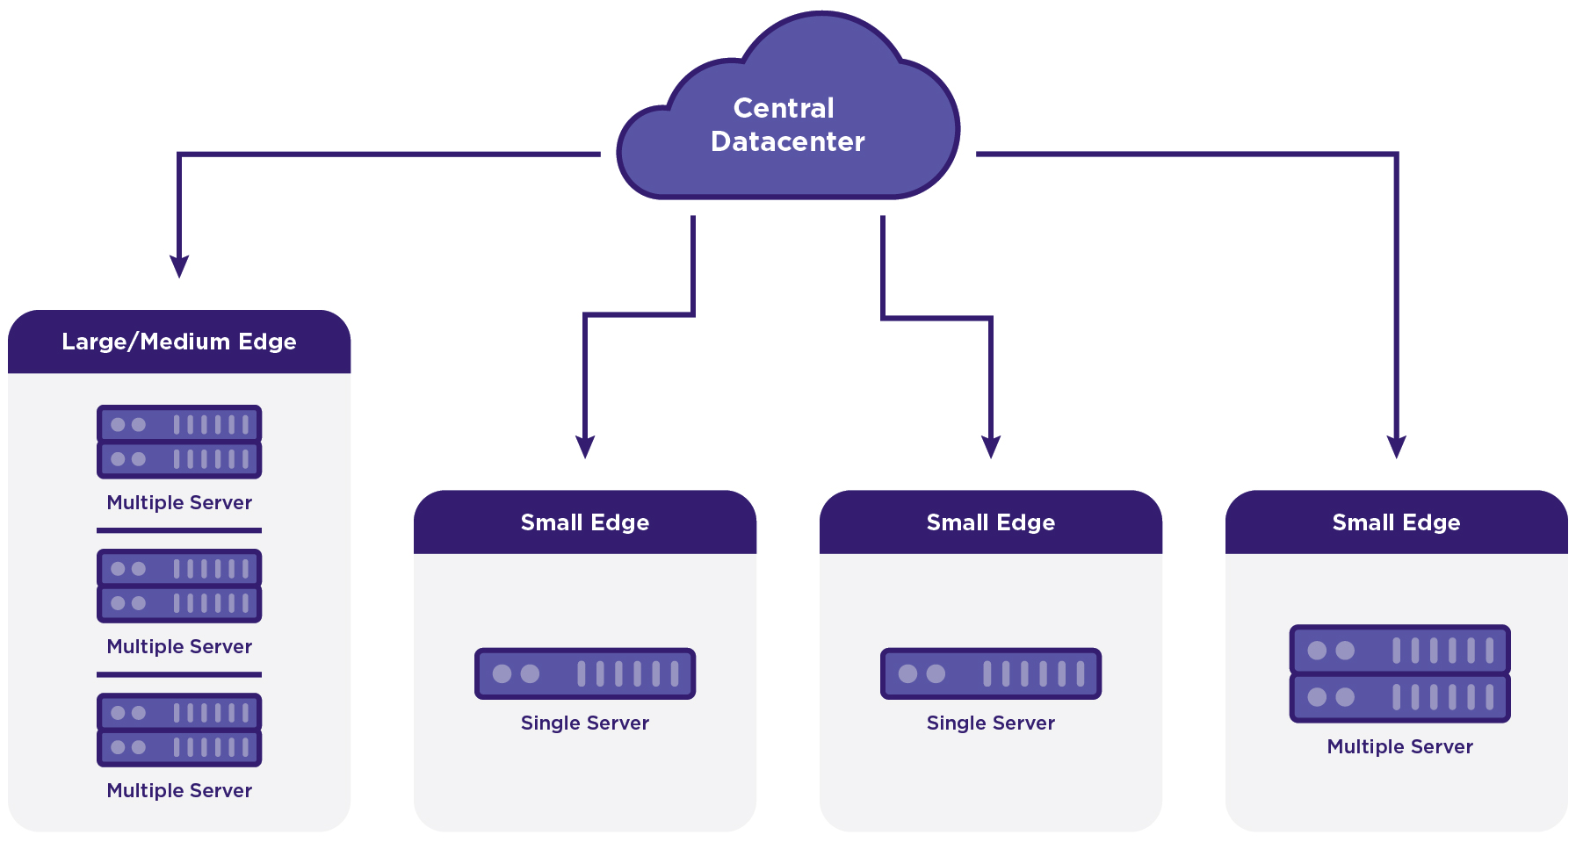
Scaling from Core to Edge
Central
Datacenter
DC sync
Central
Datacenter
Geographically distributed multi-region deployment,
Geo-Redundant Central Datacenters,
Central Datacenter providing Orchestration and Synchronization Services,
Geographically distributed remote sites of various sizes

Slide 7
StarlingX Use Case Examples
On-premises clouds for
  Industrial Automation
  Hospitals
  Transportation and Rail
Central Office clouds for
  Open RAN & vRAN
  Local data centers
  uCPE
  Multi-Access Edge Computing (MEC)
IIoT and VCS (Vehicle Cloud Services) clouds for
  Smart cities
  Autonomous vehicles with V2X (Vehicle-to-Any) communication models

Slide 8
StarlingX Technology

Slide 9
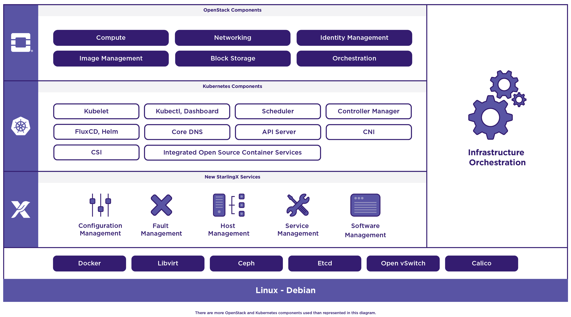
StarlingX – Edge Virtualization Platform
StarlingX provides a deployment-ready, scalable, highly reliable Edge infrastructure software platform
Services from the StarlingX virtualization platform focus on
Easy deployment
Low touch manageability
Rapid response to events
Fast recovery
A complete edge orchestration platform for bare metal, VM and container workloads
*Other names and brands may be claimed as the property of others
Notes:
StarlingX is a complete Cloud infrastructure software stack for the Edge used by the most demanding applications in industrial IOT, telecom and other use cases.
It is based on mature production software deployed in mission critical applications. We have just newly open sourced StarlingX code for Edge implementations in scalable solutions that can be productized now. It uses both OpenStack components as well as a number of proven open source building blocks to create its complete offering.
Tested and released as a complete stack, StarlingX provides a deployment-ready, scalable and highly reliable software platform to build mission critical Edge clouds.
Its unique project services include configuration, fault, service, software and host management to ensure high availability of user applications.
The StarlingX virtualization platform is designed to build up your Edge cloud quickly, manage it easily, respond and recover extremely fast.

Slide 10
StarlingX Evolution
A hardened cloud-native platform integrating OpenStack and Kubernetes on dedicated physical servers
Containerized OpenStack services based on the latest release
Closely aligned with the current OpenStack code base
  The StarlingX and OpenStack communities are working together on Edge related enhancements
Kubernetes-based edge sites for containerized workloads
Containerized Application Workloads
Containerized OpenStack
Kubernetes + OpenStack
Container
platform
StarlingX Infrastructure (flock)
Physical Servers

Slide 11
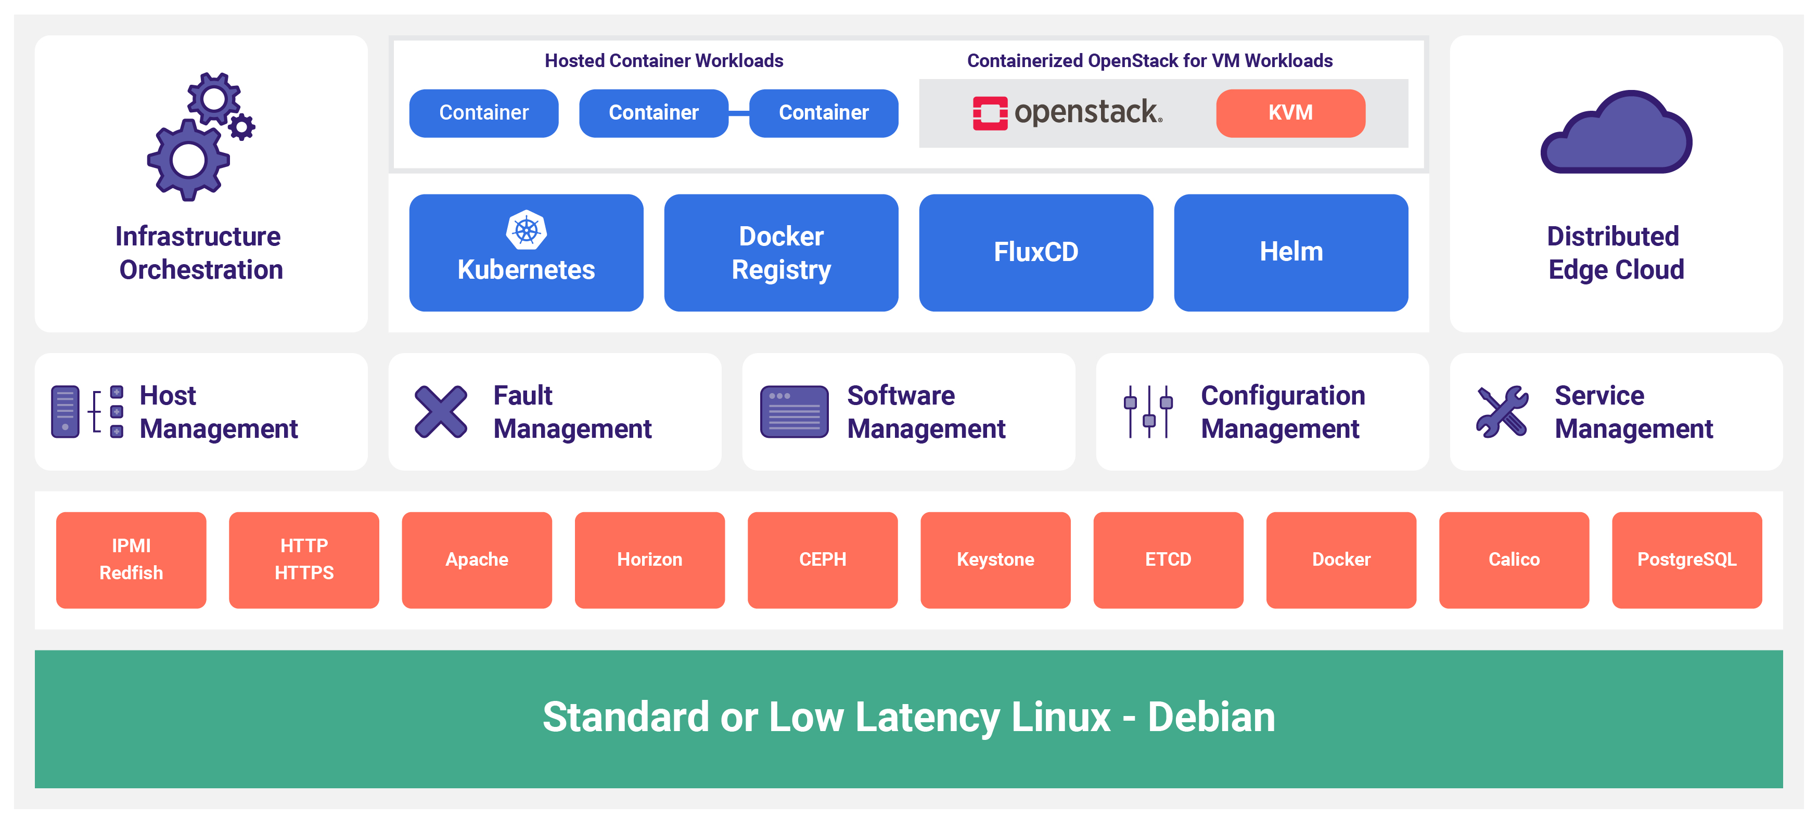
StarlingX Distributed Cloud Platform

Slide 12
StarlingX – Deployment Models
Scalable deployment models
  Standalone clouds support up to 200 k8s workers
  Distributed cloud configuration supports up to 1,000 sub-clouds
      Each sub-cloud supports up to 200 k8s workers
Minimize infrastructure footprint / overhead
  Standard (Controllers + Workers) Configuration
      Support 2-server controller/master solution
      On worker nodes, only 1 core required for StarlingX platform services
  All-In-One (AIO) Configurations (i.e. AIO-Simplex and AIO-Duplex)
      AIO servers require only 2 cores to run StarlingX platform services
Storage
  Integrated CEPH for one & two node solutions
  Co-located CEPH on master nodes for small frame level deployments
  Dedicated CEPH storage nodes for larger configurations

Slide 13
Infrastructure Management
“The Flock”

Slide 14
Configuration Management
Manages installation
  Auto-discover new nodes
  Manage installation parameters (i.e. console, root disks)
  Bulk provisioning of nodes through XML file
Nodal Configuration
  Node role, role profiles
  Core, memory (including huge page) assignments
  Network Interfaces and storage assignments
Inventory Discovery
  CPU/cores, SMT, processors, memory, huge pages
  Storage, ports
  GPUs, storage, Crypto/compression H/W
CLI
Horizon
Automation
REST API
System Inventory
(Conductor)
System Inventory
(Agents)
Puppet Resources
Hardware Resources
Puppet Resources
Hardware Resources
SQL DB
Puppet Manifests
Controllers
All Hosts
System Configuration and Setup

Slide 15
Host Management
Full life-cycle management of the host
Detects and automatically handles host failures and initiates recovery
Monitoring and fault reporting for
  Cluster connectivity, critical process failures
  Resource utilization thresholds, interface states
  H/W fault / sensors, host watchdog
  Activity progress reporting
Interfaces with board management (BMC)
  For out of band reset
  Power-on/off
  H/W sensor monitoring
Host Management
Configuration
Management
Node Maintenance
(Agent / Client)
Process Monitor
Fault
Management
Interface Monitor
Service
Management
Resource Monitor
Sensor Monitor
Infrastructure
Orchestration
Hardware
BMC
Vendor Neutral Host Management

Slide 16
Service Management
High availability manager
  Redundancy model can be N+M or N across multiple nodes
  Currently 1+1 HA Controller Cluster
Uses multiple messaging paths to avoid split-brain communication failures
  Up to 3 independent communication paths
  LAG can also be configured for multi-link protection of each path
  Messages are authenticated using HMAC SHA-512 if configured / enabled on an interface-by-interface basis
Active or passive monitoring of services
Allows for specifying the impact of a service failure
ACTIVE
STANDBY
Service Management
(SM)
Service Management
(SM)
Infrastructure Services
Infrastructure Services
Cluster Services
Cluster Services
StarlingX
Controller Node - 0
StarlingX
Controller Node - 1
High Availability for Critical Infrastructure
Notes:
Active or Passive Monitoring of Services
Passive Monitoring is done through periodic auditing and registering for asynchronous process deaths
Active Monitoring is a messaging based challenge and response of a service in addition to the passive monitoring functionality
Services managed by using LSB (Linux Standard Base) or OCF (Open Cluster Framework) compliant scripts
Supports different Service Dependency configurations
Service State Dependency (e.g. X can’t be in the enabled state unless Y is in the enabled state)
Service Action Dependency (e.g. X can’t run the enable action until Y is in the enabled state)
Asynchronous process death notification Polling/Monitoringdetection of process death
FasterFailover performance (on order of 1-2 seconds) Failover times on order of ~5 seconds
Allow for specifying recovery escalation actions per service.
Not supported.
Support for option to restart a service without restarting dependent processes.
Not supported.
Support for restart of ‘Service Manager’ without impacting monitoredservices.
Restartof Pacemaker tears down all services.

Slide 17
Fault Management
Framework for infrastructure services via API
  Set, clear and query customer alarms
  Generate customer logs for significant events
Maintains an Active Alarm List
Provides REST API to query alarms and events
Support for alarm suppression
Operator alarms
  On platform nodes and resources
  On hosted virtual resources
Operator logs - Event List
  Logging of set/clear of alarms
  Related to platform nodes and resources
  Related to hosted virtual resources
CLI
Horizon
SNMP
Configuration
Management
Fault Management
Host
Management
FM REST API
SNMP
Fault Management
(Manager)
Service
Management
SQL DB
Infrastructure
Orchestration
Fault Alarming and Logging

Slide 18
Software Management - in progress
Automated deploy of software updates for security and/or new functionality
Integrated end-to-end rolling upgrade solution
  Automated, low number of steps
  No additional hardware required for upgrade
  Rolling upgrade across nodes
In-service and reboot required patches supported
  Reboot required for kernel replacement etc.
  VM live migration is used for patches that require reboot
Manages upgrades of all software
  Host OS changes
  New / upgraded StarlingX service software
  New / upgraded OpenStack software
CLI
Horizon
Software Management
(Controller)
Software Management
(Agent)
Infrastructure Orchestration
Software Update
(Service Scripts)
RPMS
Controllers
All Hosts
Software Upgrades and Patching
Notes:
Been doing this for 5 releases incuding skipping releases
Kilo->Mitaka
Newton->Pike

Slide 19
Container Platform

Slide 20
Kubernetes Cluster Software Components
Kubernetes Master
API Server
Docker Registry
Full infrastructure and cluster orchestration
Security and Policy
Control Plane
FluxCD
Scheduler
Nginx
Helm
Controller Manager
ETCD
Kubernetes Worker (kubelet)
Flexible ecosystem of base OS
Evolution to other container runtimes
Kernel and Accelerated networking
CRI-O
containerd
CRI
Docker
Application Containers
Worker Nodes
CNI
Calico
Multus
SRIOV
Other
Device
Plugins
SRIOV
GPU
FPGA
QAT
Runtime
App/Service
Base OS
runc
nvidia
kata
Host Abstraction
Host OS
cgroups
namespaces
overlayfs
drivers

Slide 21
Kubernetes Deployment Architecture
Active
Standby
Kubernetes deployed in a highly available configuration
  Deployed in a 1:1 service model
  All-in-One Simplex/Duplex deployments supported using same service management
Requests directed to active instances via cluster floating IP address
DRBD backed file system for redundant persistent storage
Service availability and activity managed by Service Management (SM)
  Handles HA sparing of individual services
  Actively monitors host, service and network availability
  Mitigates split-brain scenarios
Kubernetes Master
Kubernetes Master
kube-apiserver
kube-apiserver
kube-controller-manager(s)
kube-controller-manager(s)
cluster-ip
cluster-ip
Kubernetes Worker
Kubelet
Docker
Notes:
Split brain results in pods on the controller without the floating IP being marked as NodeLost because the kube-apiserver does not hear from the kubelet. This is handled the same way as a node failure.

Slide 22
Cluster Persistent Storage
Ceph uniquely delivers object, block, and file storage in one unified system
Highly scalable and highly available deployment with distributed Ceph monitors and Object Storage Devices (OSD) for data replication
  Automatic cluster storage deployment and replication
  Unified storage solution for all deployments: AIO-SX/DX, Standard, Multi-cloud
  Fully managed Ceph Cluster Map (hyper-scale)
Kubernetes persistent storage provided by Ceph's RADOS Block Devices (RBD) provisioner
  Persistent Volumes (PVs) and Claims (PVCs)
  Default Storage Class
Support for Rook to add additional storage backend options
OpenStack backend storage solution for services: Glance, Cinder, Swift, Nova
Kubernetes Cluster
controller node
controller node
Controller Services
Controller Services
Ceph Monitor
Ceph Monitor
worker nodes
storage node
Pod
Pod
Pod
Ceph Monitor
worker services
Ceph OSDs
compute nodes
storage nodes
GUEST
VM
GUEST
VM
GUEST
VM
compute services
Ceph OSDs

Slide 23
Kubernetes Cluster Networking
Calico provides a pure L3 fabric solution for interconnecting containers
Calico leverages the Linux kernel for routing and policy enforcement
Calico leverages Border Gateway Protocol (BGP) for control plane
Calico leverages Open Standards and is a full Open Source network solution
Calico is highly scalable, and is operator and policy friendly:
  No overlay, no tunnelling, no VRF tables (no overhead) – pure routing
  Access Controls enforced through L3/L4 security policies
Kubernetes Cluster
Calico Control Plane
Pod A
Pod B
Ingress Gateway
Calico
APP
APP
Egress Gateway
Kernel (Network Policy Enforcement)
Public
Kernel (Network Routing)

Slide 24
Kubernetes Accelerated Networking
Multus, SR-IOV, DPDK
Kubernetes managed accelerated network devices (via Device and CNI plugins)
Containers bind the driver to the Virtual Function (VF) or DPDK devices directly
No host routing or switching is involved for SRIOV and provides the best direct IO
Worker Node
Worker Node
Compute or Bare Metal Node
Pod1
Pod2
Pod3
Pod4
APP
APP
APP
APP
Native or Virtualized
APP
ETH0
ETH0
ETH1
ETH0
ETH0
ETH1
Host Routing
Host Routing
NIC1
VF1
VF2
NIC1
VF1
NIC1

Slide 25
Additional Capabilities
Local replicated docker image registry
Integration with OpenStack Keystone
  Local docker image registry authentication
  Authentication/authorization of StarlingX REST API
Huge Page support
  Enables pods to allocate and consume huge pages from pre-allocated host pool
Kubernetes CPU manager static policy
  Enables applications to reserve exclusive CPUs in their pod spec

Slide 26


Application Management
Helm
  Helm Charts help you define, install, and upgrade even the most complex Kubernetes application.
  Template based approach to Kubernetes configuration
  System and User overrides combined to provide final deployment configuration
Flux
  Manages the dependencies between multiple Helm Charts and expression of those relationship
  Static and default configuration attributes
Application
  Curated software bundle of Flux manifest and Helm Charts
  Application-specific Plugin support for customized behavior (e.g., intelligent helm override defaults based on system configuration)
  Application lifecycle coordinated by Configuration Management
  User uploads, applies / removes application with single command operations
Controller Node
.tar.gz
Flux Manifest
Flux
Helm
Configuration
Application
Helm Charts & Overrides
Configuration
Management
Kubernetes
DB
Registry

Slide 27
OpenStack

Slide 28


OpenStack Deployment
OpenStack is deployed as a containerized Kubernetes application
  OpenStack control plane running in pods
  OpenStack virtual machines running on hosts
  Leverages Kubernetes’ strengths to manage, scale and update the OpenStack services
Deployed using Helm (using OpenStack-Helm charts) and FluxCD (StarlingX default orchestrator for deploying Helm charts)
StarlingX provides application APIs to install and configure the containerized OpenStack application
  Application tarball contains helm charts and armada manifest for StarlingX
  Automatic generation of helm configuration values based on system configuration
  User can easily customize helm configuration of OpenStack Services
Notes:
Application
Curated software bundle of Armada manifest and Helm Charts
Application lifecycle coordinated by Configuration Management
User uploads, applies / removes application with single command operations

Slide 29
Supported OpenStack Services
Configuration optimized and system validated within StarlingX
Supported OpenStack services include:
  Cinder
  Glance
  Heat
  Horizon
  Keystone
  Neutron
  Nova

Slide 30
Day 2 Configuration Changes
Configuration changes can be applied after the application has been deployed
Update the helm chart overrides
  system helm-override-update …
Reapply the application
  system application-apply …
Only charts impacted by the configuration change will be updated

Slide 31
Distributed Cloud

Slide 32
Distributed Cloud Overview
Introduced in StarlingX 3.0
Heterogeneous Distribution of Kubernetes and OpenStack Clouds
Central Cloud (System Controller)
  Hosting shared services
  System-wide infrastructure orchestration functions
    Install, Orchestrate / Automate Software Patching & Upgrade, and more
  Highly scalable; up to 1000x remote sites
  Supporting geo-redundant Central Clouds
Remote, geographically dispersed sites
  An autonomous cloud managed by the Central Cloud through REST APIs/L3
  Scalable from single server to 100s of servers
In line with the Distributed Control Plane reference architecture model defined by the OpenInfra Edge Computing Group

Slide 33
Distributed Cloud - System Controller
Supports active / active geo-redundant configuration
Centrally orchestrated & automated operations on remote sites
  Install and initial configuration
  Backup & restore
  Software patching and upgrades
  Certificate management
  Firmware management
Supports environments with poor / high latency to remote sites
Health monitoring and management of remote sites
Synchronized User Authentication & Authorization with Keystone
Centralized Docker registry for infrastructure and applications
Centralize Horizon dashboard - single pane of glass
Configuration portal for shared platform data
  DNS, NTP/PTP, API Firewall, SNMP, …

Slide 34
Community and Contributing

Slide 35
Principles
The StarlingX project follows the “four opens,”
  Open Community
  Open Design
  Open Development
  Open Source
Technical decisions will be made by technical contributors and a representative Technical Steering Committee.
The community is committed to diversity, openness, encouraging new contributors and leaders to rise up.

Slide 36
Sub-project Structure
Main sub-projects
  New functionality and services
Supporting sub-projects
  Supporting services, test and infrastructure
Sub-project team structure
  1 Technical Lead
  1 Project Lead
  Core Reviewers
  Contributors
Technical Steering Committee
StarlingX Main Sub-projects
Distributed Cloud
Flock Services
StarlingX Supporting Sub-projects
Build
Containers
Distro
Docs
Networking
OpenStack Distro
Release
Security
Test

Slide 37
Governance Roles
Contributor
  Someone who made a contribution in the past 12 months
    Code, test or documentation
    Serving in a leadership role
  Can run and vote for elected positions
Core Reviewer
  Active contributors to a sub-project, appointed by fellow core reviewers
  Responsible for reviewing changes and specifications
  Can approve code and documentation changes

Slide 38
Governance Roles
Technical Lead
  Per sub-project
  Core Reviewer with additional duties
  Helps guiding the technical direction of a sub-project
Project Lead
  Sub-project level coordination work
    Tracks and communicates progress and priorities
  Sub-project ambassador

Slide 39
Governance Bodies
Technical Steering Committee (TSC)
  Responsible for overall project architectural decisions
  Managing the sub-project life-cycle
  Making final decisions if sub-project Core Reviewers, Technical Leads or Project Leads disagree
  The TSC members are selected by the community through an election process

Slide 40
Get Involved
Code and documentation are available through git
  https://opendev.org/starlingx
Apache 2 license
Chat: Matrix - https://matrix.to/#/#starlingx:opendev.org
Mailing List for daily discussions
  https://lists.starlingx.io/mailman3/lists/starlingx-discuss.lists.starlingx.io/

Slide 41
Where to Contribute?
Bugs are tracked in Launchpad
  https://bugs.launchpad.net/starlingx
New ideas are introduced in the specs repository
  https://opendev.org/starlingx/specs
Design and implementation work is tracked in StoryBoard
  https://storyboard.openstack.org/#!/project_group/86
Further information about sub-teams and processes
  https://wiki.openstack.org/wiki/StarlingX

Slide 42
Community
You do not need to be an Individual Member of the Open Infrastructure Foundation in order to contribute, but if you would like to participate in the project’s elections or vote in the annual Open Infrastructure Foundation Board of Directors election, you may join: https://openinfra.dev/join/individual/
If you are contributing on behalf of an employer, they will need to sign a corporate contributor license agreement, which now covers all projects hosted by the Open Infrastructure Foundation (same model such as Apache and CNCF)

Slide 43
Communication
General room in the StarlingX space on Matrix for online discussions
  https://matrix.to/#/#starlingx:opendev.org
Mailing Lists: lists.starlingx.io
Email: info@starlingx.io
Weekly meetings:
  Zoom calls
  https://wiki.openstack.org/wiki/Starlingx/Meetings
Twitter handle: @StarlingX
Notes:
You have an opportunity to get involved in several ways:
Stay updated with the mailing list
Attend the community meetings
Try out the code. Please do try out the code.
And also, join us as a member company at any level

Slide 44
Thank You!

